Slide 1

Department of Computer Science And Engineering
Data Structure(CSE207)
Project on: AA Tree
Author
Imran Hosen

Slide 2
Introduction to AA Trees:
A type of balanced binary search tree.
Developed as a simpler alternative to red-black trees and other balanced trees.
Introduced by Arne Andersson (hence the AA) in 1993
Eliminates many of the conditions that need to be considered to maintain a red- black tree
Fewer conditions means AA trees are easier to implement
Comparable in performance to red-black trees.

Slide 3
Similar to red-black trees, but with the addition of a single new rule
Every node is colored either red or black
The root node is black
If a node is red, its children must be black
Every path from a node to a null link must contain the same number of black nodes.

Slide 4
AA trees utilize the concept of levels to aid in balancing binary trees
-The level of a node represents the number of left links on the path to
the nullNode.
AA Tree Diagram:
One special rule is left children may not be balck.

Slide 5
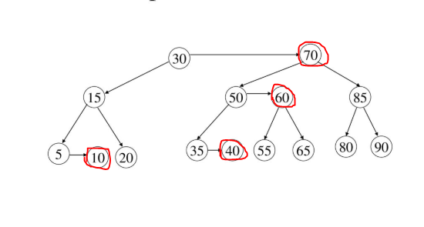
Representation of AA Tree using level information:

Slide 6
AA trees must always satisfy the following five invariants:
1) The level of a leaf node is 1
2) The level of a left child is strictly less than that of its parent
3) The level of a right child is less than or equal to that of its parent
4) The level of a right grandchild is strictly less than that of its grandparent
5) Every node of level greater than one must have two children

Slide 7
Insertion
A new item is always inserted at the bottom level
It will create a horizontal left link.
In the insertion it generates consecutive right links.
After inserting at the bottom level, we may need to perform rotations to restore the horizontal link properties

Slide 8
skew - remove left horizontal links
P
X
P
X
A
B
C
A
B
C

Slide 9
split - remove consecutive horizontal links
P
X
P
G
X
G
A
B
A
B

Slide 10
skew/split
A skew removes a left horizontal link
A skew might create consecutive right horizontal links
We should first process a skew and then a split, if necessary
After a split, the middle node increases a level, which may create a problem for the original parent

Slide 11
Real world applications of AA Tree
So, we’ve just got some AA theory, but one may ask is this really useful? In fact, it pretty is. They are common in the Linux kernel. For example in a process scheduler or for keeping track of the virtual memory segments for a process. They are also used in map, multimap, multiset from C++ STL and java.util.TreeMap , java.util.TreeSet from Java. Besides they are use in K-mean clustering algorithm for reducing time complexity.

Slide 12
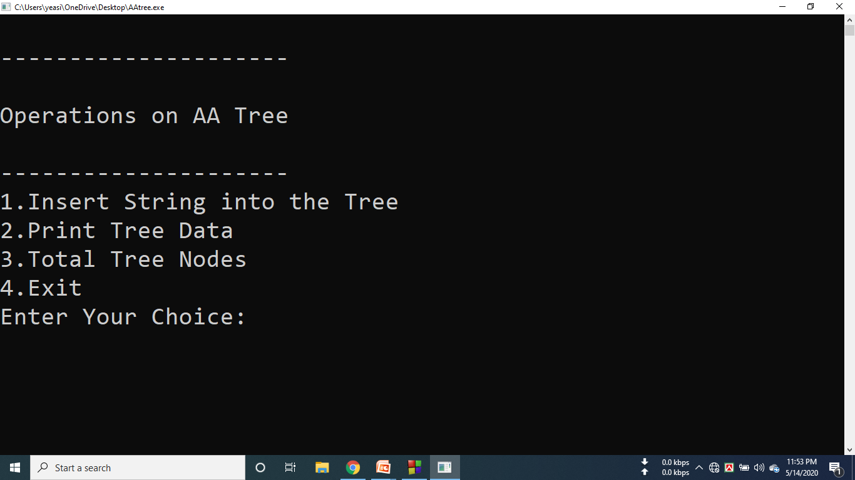
Menu of our ADT

Slide 13
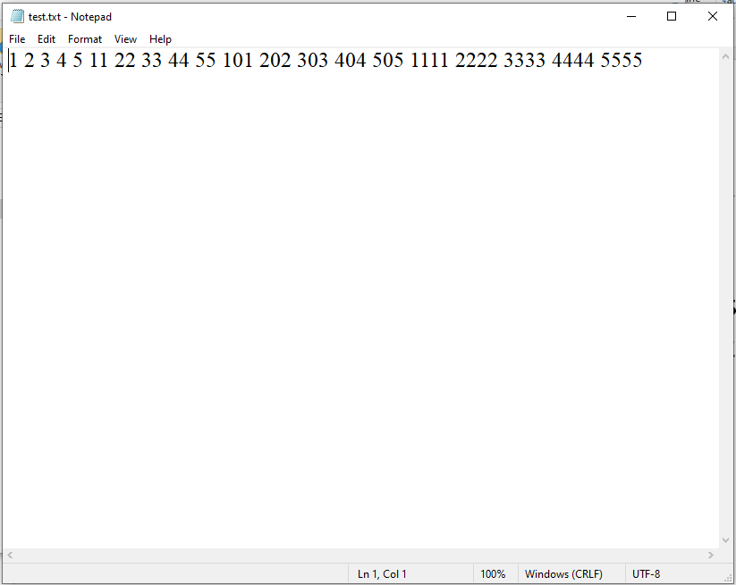
Input from text.txt file:

Slide 14
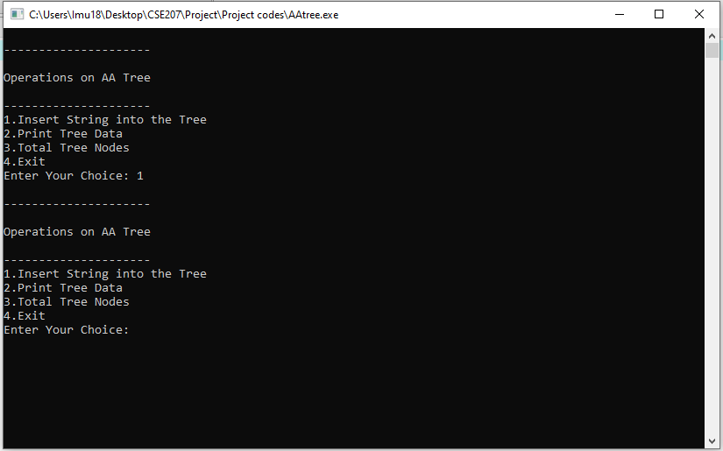
Insertion in AA Tree

Slide 15
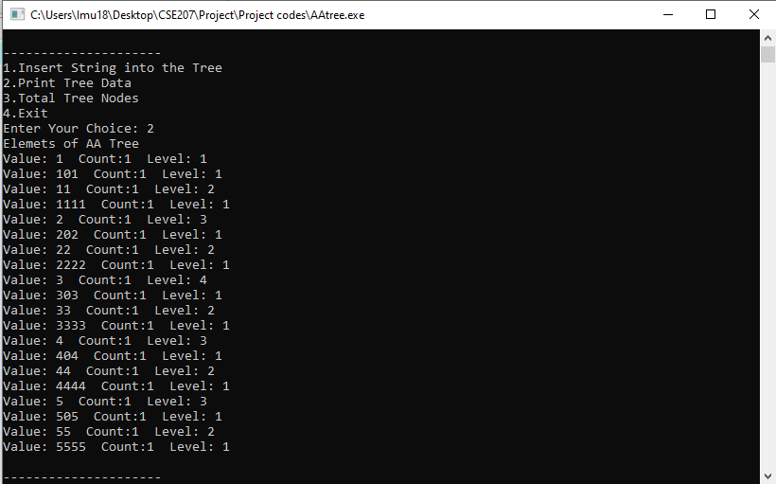
Displaying data of the Tree

Slide 16
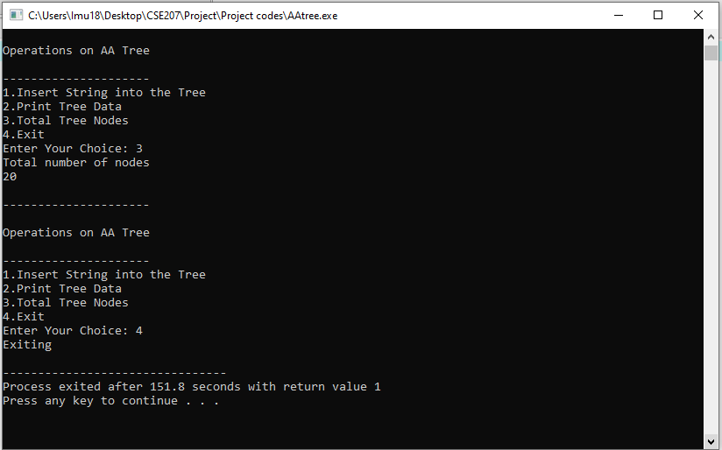
Printing total number of nodes

Slide 17
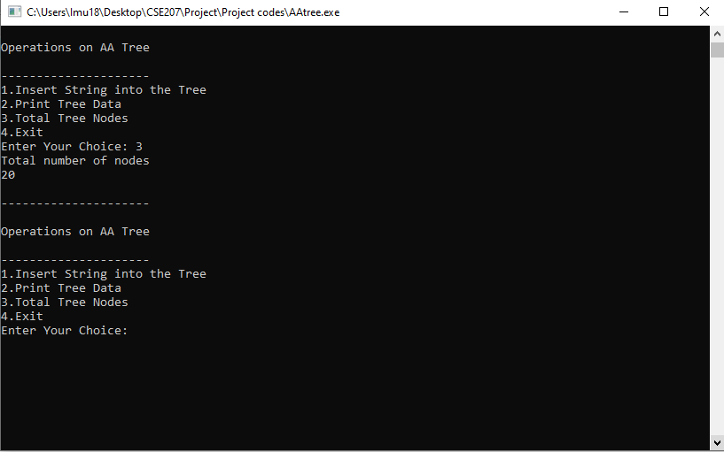
Exit from the previous tree

Slide 18


